Slide 1
The Tectonic Evolution of North America During the Mesozoic Era
By
Notes:
Limit your sources. The majority of your research should come from your Levin textbook.

Slide 2
5 Major Events
Notes:
Listed after this slide are 5 events of the Mesozoic. You may research the events listed for you OR choose different events that interest you. You must describe the event and include geologic evidence that this event occurred, typically rocks or soil created during the event. Page numbers in this section refer to Levin’s The Earth Through Time 10th ed. Any sources used must be included in your presentation with in-text citations and an entry in the Works Cited slide at the end of the presentation.

Slide 3
Breakup of Pangaea
Notes:
Example of an event slide that would earn all points.

Slide 4
Sonoma Orogeny
Notes:
See pgs 285-287

Slide 5
Nevadan Orogeny
Notes:
See pages 291-296

Slide 6
Sevier Orogeny
Notes:
See pg 320

Slide 7
Laramide Orogeny

Slide 8
Paleogeography of the Mesozoic
Notes:
In this section, you will describe the paleogeography of the Mesozoic. Maps have been included for you. You must interpret the maps. All images in this section were obtained from Levin’s The Earth Through Time 10th ed. Please see the Ordovician example.

Slide 9
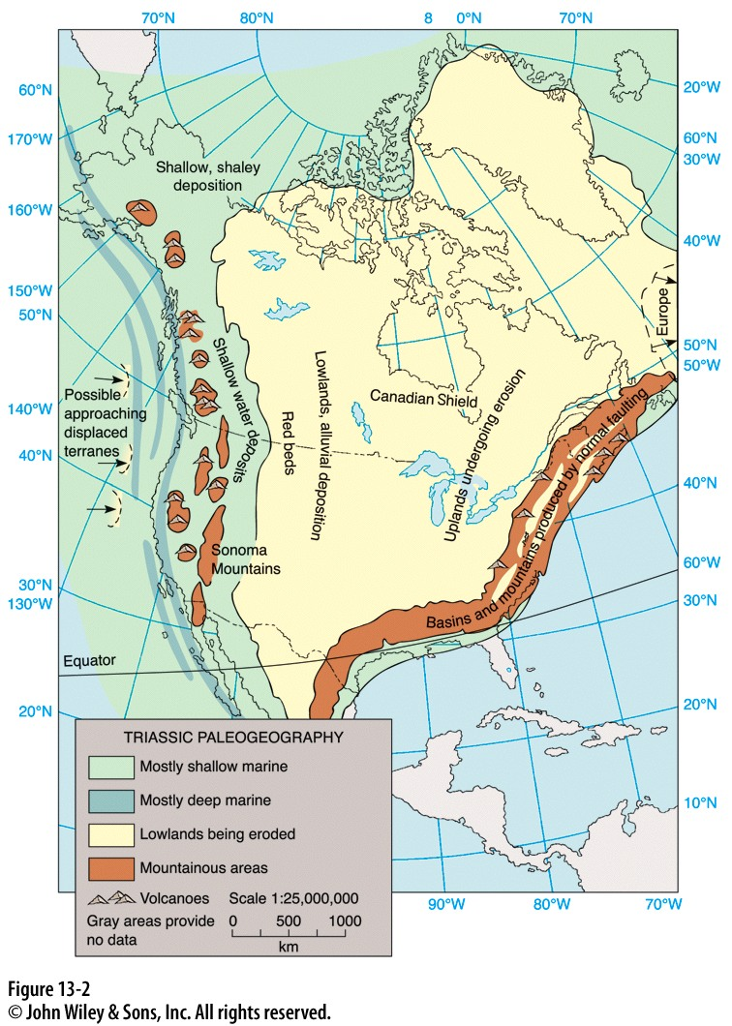
Triassic, pg 388

Slide 10
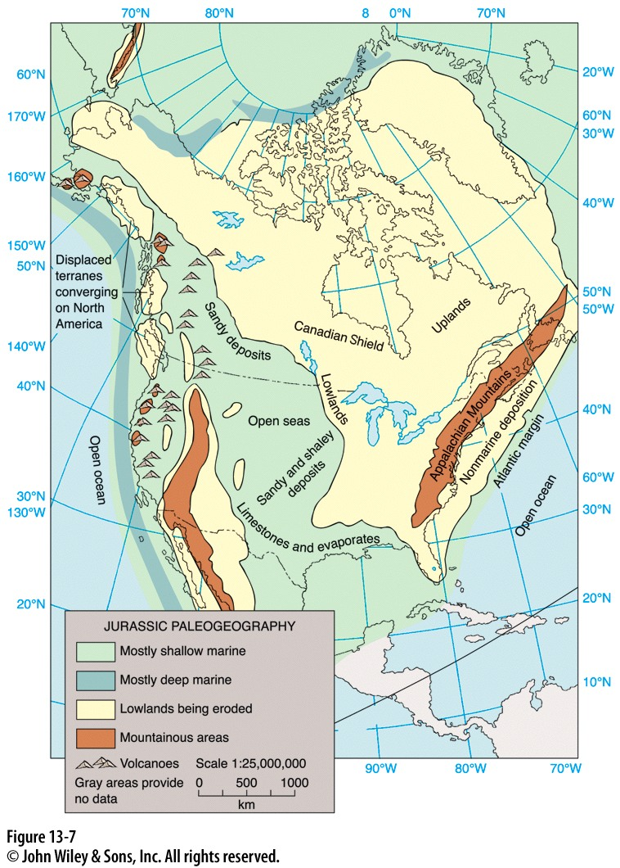
Jurassic, pg 391

Slide 11
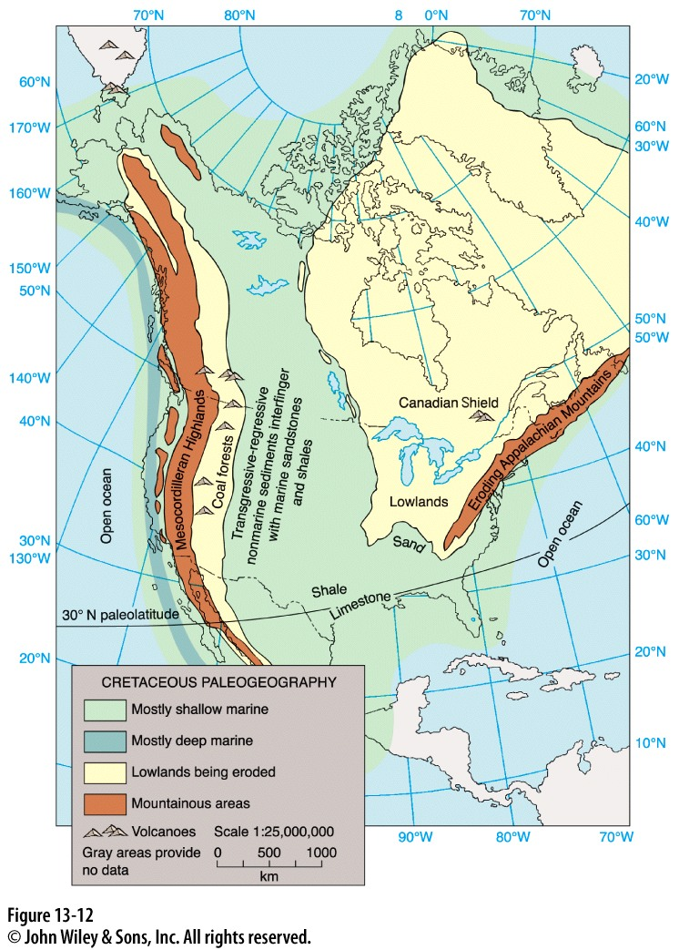
Cretaceous, pg 396

Slide 12
Works Cited
Levin, Harold. The Earth Through Time. 10th ed. Hoboken, NJ: John Wiley and Sons, Inc., 2013. Print.

